Slide 1


Tony Primerano
09/08/2023

Slide 2

Outline
Executive Summary
Introduction
Methodology
Results
Conclusion
Appendix

Slide 3

Executive Summary
Summary of methodologies
This project followed the steps for analysis listed below:
Data Collection
Data Wrangling
Exploratory Analysis - SQL
Interactive Visual Analytics - Folium, Plotly
Predictive Analysis - Classification
Summary of all results
The following visualizations and outputs were produced:
Exploratory Data Analysis results
Geospatial Data
Interactive Dashboard
Predictive Analysis of Classification Models

Slide 4
Introduction
SpaceX launches the Falcon9 rocket for an estimated cost of $62m per launch compared to $165m per launch from other industry providers. These savings are due to SpaceX’s ability to land and re-use the first stage of the rocket for subsequent launches.
If we are able to make predictions regarding the first stage’s ability to land, we can determine the cost per launch and assess whether SpaceX or an alternate company should bid for a rocket launch.
This project will ultimately predict if the Falcon9 first stage from SpaceX will land successfully.

Slide 5

Section 1

Slide 6
Methodology
Executive Summary
Data collection methodology:
GET requests were made to the SpaceX REST API
Web Scraping from Wikipedia
Perform data wrangling:
One-hot encoding was applied to categorical features
.fillna() used to remove NaN values
Landing outcome label was created to show:
0 for unsuccessful landings
1 for successful landings
.value_counts() was used to determine:
number of launches for each site
number of occurrence for each orbit
occurrence and number of outcomes for each orbit
Exploratory Data Analysis (EDA) using visualization and SQL:
Using SQL queries, the data was manipulated and evaluated
Pandas and Matplotlib were used to visualize relationships and determine patterns
Perform interactive visual analytics using Folium and Plotly Dash:
Geospatial Analytics using Folium
Interactive dashboard created using Plotly Dash
Perform predictive analysis using classification models:
Data was standardized
Train_test_split used to split data into train and test sets
Trained different classification models on the data
Found hyperparameters using GridsearchCV
Confusion matrices for each model were plotted
Accuracy of each model was assessed

Slide 7
Data Collection - SpaceX REST API
The SpaceX REST API was used to retrieve data pertaining to launches of the Falcon9 rocket, including the rocket used, payload delivered, launch specifications, and landing outcomes.
GET requests were made to the API
Responses were decoded as a .JSON file and turned into a dataframe using Pandas
Data was cleaned and missing values were filled
Web Scraping through BeautifulSoup was used to obtain launch records for Falcon9
Objective: extract launch records as HTML table, parse the table and convert it to a Pandas dataframe for future analysis

Slide 8
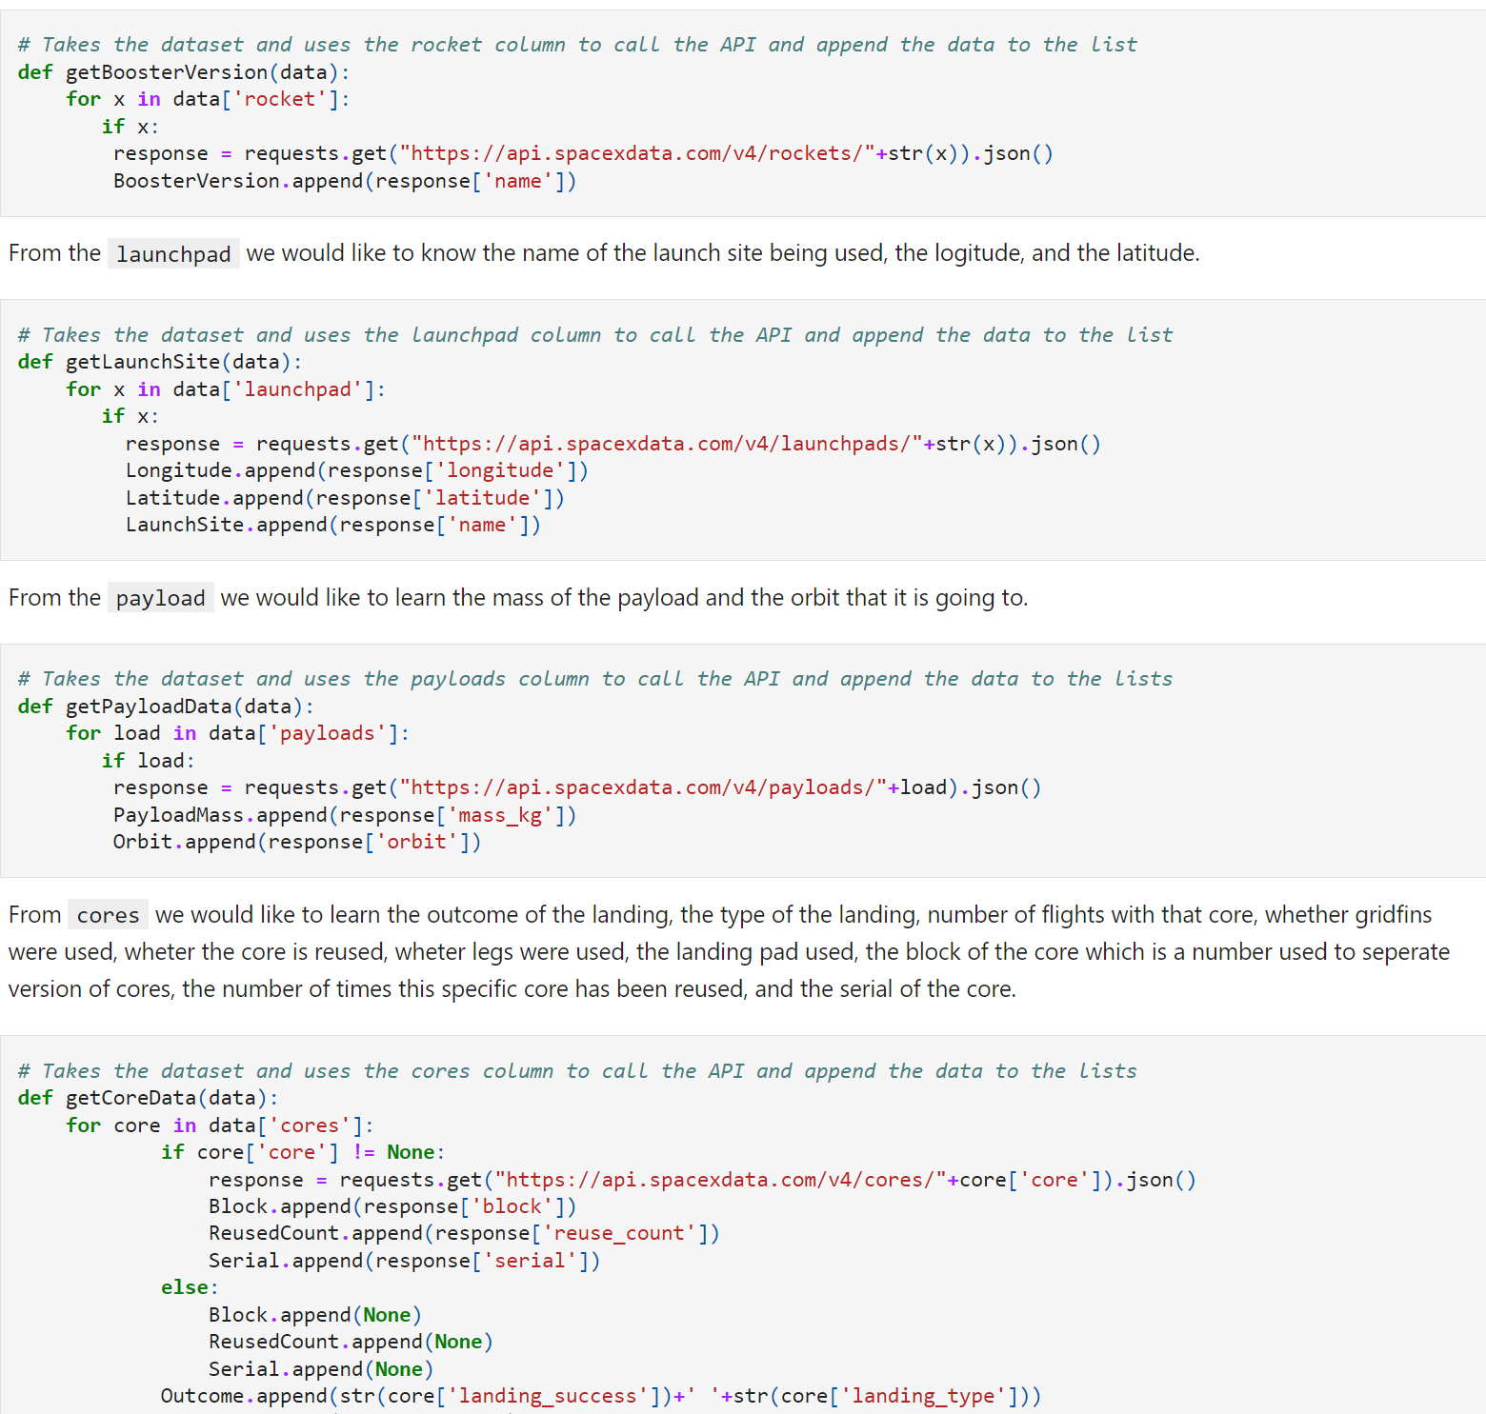
Data Collection – SpaceX API
The code used can be viewed at: https://github.com/Tonyprimo/Capstone/blob/c7d133f0d26e9c577bdce2a99f5266c00be232b4/Collecting%20the%20Data/jupyter-labs-spacex-data-collection-api.ipynb
Place your flowchart of SpaceX API calls here
Steps:
Request launch data from SpaceX API
Decode response as .JSON file
Request information about the launches using custom functions
Create dictionary for data
Create dataframe
Filter dataframe to include only Falcon9
Replace missing values for payload mass with calculated mean
Export the data to .CSV file

Slide 9
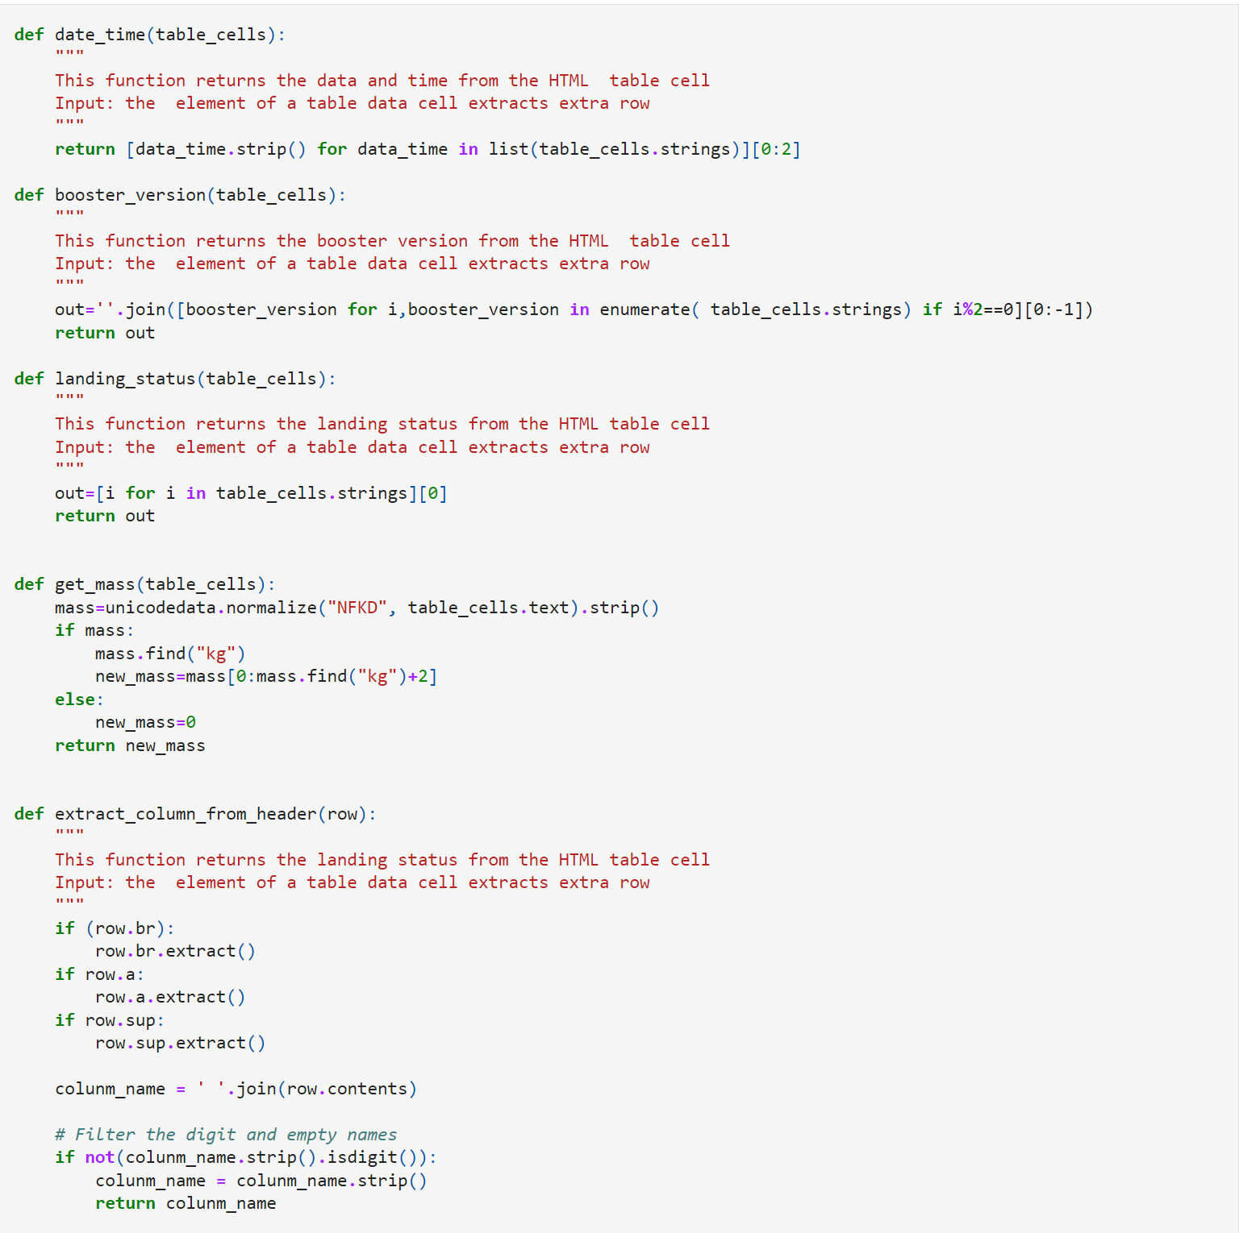
Data Collection - Web Scraping
The code used can be viewed at:
https://github.com/Tonyprimo/Capstone/blob/c7d133f0d26e9c577bdce2a99f5266c00be232b4/Collecting%20the%20Data/jupyter-labs-webscraping.ipynb
Steps:
Request Falcon9 launch data from Wikipedia
Create BeautifulSoup object from HTML response
Extract column names from the table header
Parse HTML table to collect data
Create dictionary from the data
Create dataframe from the dictionary
Export the data to .CSV file
Place your flowchart of web scraping here

Slide 10
Data Wrangling
The code can be viewed at:
https://github.com/Tonyprimo/Capstone/blob/c7d133f0d26e9c577bdce2a99f5266c00be232b4/Data%20Wrangling/IBM-DS0321EN-SkillsNetwork_labs_module_1_L3_labs-jupyter-spacex-data_wrangling_jupyterlite.jupyterlite.ipynb
Steps:
perform EDA and determine labels for data
Calculate the number of launches for each site, number of occurrences of orbit, and occurrence of mission outcome per orbit.
create a binary landing outcome column
export data to .CSV file
Landing Outcomes:
landing was not always successful
True Ocean: outcome was successful landing to specific region of the ocean
False Ocean: outcome was failed landing to specific region of the ocean
True RTLS: outcome was successful landing on ground pad
False RTLS: outcome was failed landing on ground pad
True ASDS: outcome was successful landing on a drone ship
False ASDS: outcome was a failed landing on a drone ship
Outcomes were converted into 0 for failed landings and 1 for successful landings

Slide 11
EDA with Data Visualization
Code can be viewed at:
https://github.com/Tonyprimo/Capstone/blob/c7d133f0d26e9c577bdce2a99f5266c00be232b4/Exploratory%20Analysis/IBM-DS0321EN-SkillsNetwork_labs_module_2_jupyter-labs-eda-dataviz.ipynb.jupyterlite.ipynb
Charts:
Flight Number vs Payload
Flight Number vs Launch Site
Payload Mass (kg) vs Launch Site
Payload Mass (kg) vs Orbit Type
Analysis:
Relationships were viewed using scatterplots in order to determine if the variables would be useful for machine learning model.
Comparisons were shown using bar charts for categorical data to determine presence of relationships among the categories and a measured value.

Slide 12
EDA with SQL
Code can be viewed at:
https://github.com/Tonyprimo/Capstone/blob/c7d133f0d26e9c577bdce2a99f5266c00be232b4/Exploratory%20Analysis/jupyter-labs-eda-sql-coursera_sqllite.ipynb
Queries used:
Display:
Names of unique launch sites
5 record where the launch site name begins with “CCA”
Total payload mass carried by boosters from NASA (CRS)
Average payload mass carried by booster version F9 v1.1
List:
first successful landing on ground pad date
Names of boosters from successful landings on drone ship with masses between 4,000-6,000 kg
Total successful landings on ground pad
Names of booster versions carrying max payload
Failed outcomes on drone ships with their respective booster versions and launch sites for the year 2015
Count of landing outcomes from June 2010 to March 2017 in descending order

Slide 13
Build an Interactive Map with Folium
Code can be viewed at:
https://github.com/Tonyprimo/Capstone/blob/c7d133f0d26e9c577bdce2a99f5266c00be232b4/Interactive%20Visual%20Analytics/IBM-DS0321EN-SkillsNetwork_labs_module_3_lab_jupyter_launch_site_location.jupyterlite.ipynb
Launch Site Markers:
Blue circle indicates NASA Johnson Space Center with a pop up for its name using latitude and longitude for the center
Red circles indicate all launch site coordinates with a pop up for its respective name using latitude and longitude
Colored Markers for Launch Outcomes
Colored markers were added for each launch outcome for each launch site. Green markers were used to indicate successful outcomes while red markers were used to indicate failed outcomes. This was used to aid in determining which launch site has the highest success rate.
Distance Between Launch Site to Proximities:
colored lines show the distance between launch site CCAFS SLC-40 and its proximity to the nearest Coastline, highway,city, and railway system.

Slide 14
Build a Dashboard with Plotly Dash
Pie Charts: Built to show the successful launches per launch site
Drop downs were created to be able to filter results for the successes and failures at each site.
Scatter plot: Built to show relationships between Payload Mass (kg) and outcome of the launch.
Range sliders were created to filter results by payload.
An additional filter was created to filter by booster version.
Code can be viewed at:
https://github.com/Tonyprimo/Capstone/blob/c7d133f0d26e9c577bdce2a99f5266c00be232b4/Interactive%20Visual%20Analytics/spacex_dash_app.py

Slide 15
Predictive Analysis (Classification)
Model Development:
To prepare the dataset for the model, the data was standardized and pre-processed, split into training and testing data using train_test_split(), and then used to determine which algorithm was the best fit for the model.
For each algorithm, GridSearchCV was used to create objects and parameters, the objects were then fitted to parameters, and the training data was used to train the model.
Model Evaluation:
Using the output from each GridSearchCV, the tuned hyper parameters were checked using best_params_, accuracy was checked using score and best_score_, and a confusion matrix was plotted.
Best Classification model:
accuracy scores for all algorithms were reviewed and the best model was determined by the algorithm with the highest accuracy score to be the best performing model.
Code can be viewed at:
https://github.com/Tonyprimo/Capstone/blob/16c45dc7b73b79a2bb7f8e5b8b874cfccfd14615/predictive%20analysis/IBM-DS0321EN-SkillsNetwork_labs_module_4_SpaceX_Machine_Learning_Prediction_Part_5.jupyterlite.ipynb

Slide 16
Results
Exploratory data analysis results
Interactive analytics demo in screenshots
Predictive analysis results

Slide 17

Section 2

Slide 18
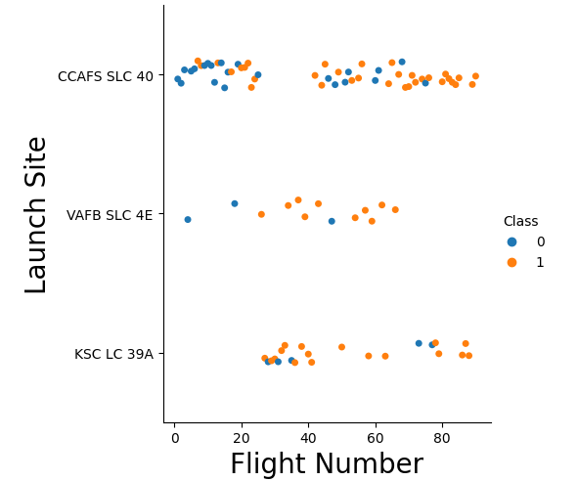
Flight Number vs. Launch Site
Early stage flights (flight numbers < 30) launched from CCAFS SSLC40 were unsuccessful.
VAFB SLC4E showed the same pattern with early stage flights, but then quickly tended to higher success rates after 30.
No early flight stages were conducted at KSC LC 39A, but most flights were successful.
After 30 flights, the number of successful launches increased significantly.

Slide 19
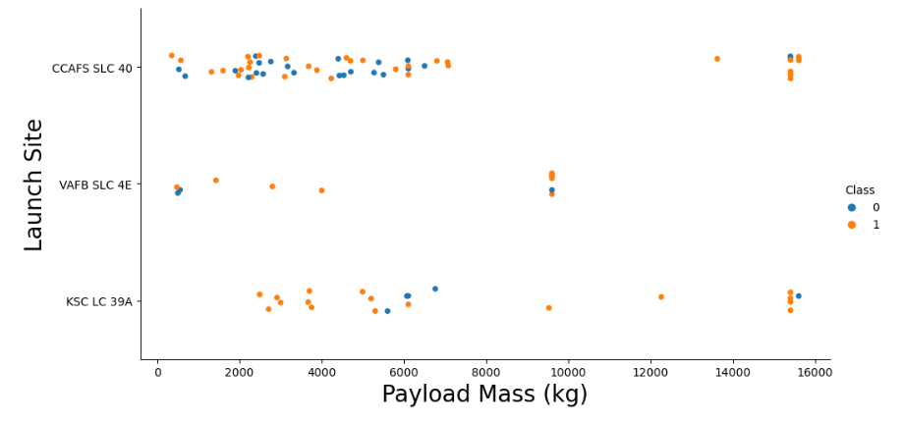
Payload vs. Launch Site
When payload was > 7000kg, success rate decreased.
No correlation was shown between payload and success rate for each site.
most launches were conducted with a payload < 7000kg.

Slide 20
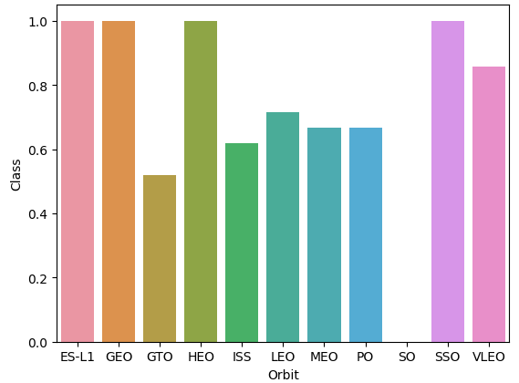
Success Rate vs. Orbit Type
100% success rate shown for Earth-Sun First Lagrangian point (ES-L1), Geostationary Orbit (Geo), High Earth Orbit (HEO), and Sun Synchronous Orbit (SSO).
0% success rate for Heliocentric Orbit (SO).

Slide 21
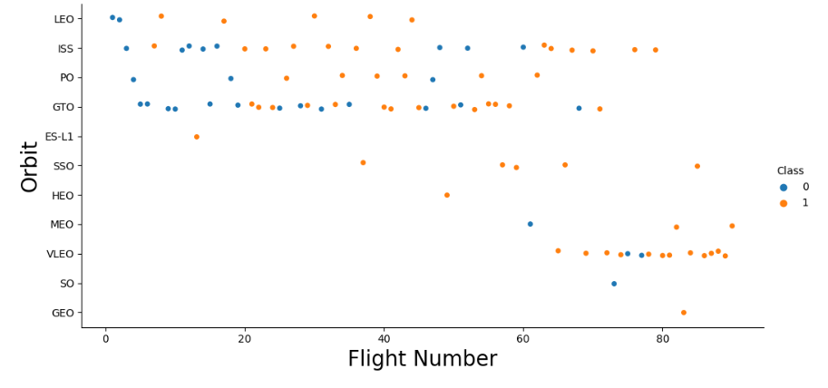
Flight Number vs. Orbit Type
GEO, HEO, ES-L1 had only 1 flight each, but had 100% success.
SSO had 5 flights with 100% success.
There was little to no relationship shown between flight number and success rate for GTO.
LEO only failed during low flight numbers.
As flight numbers increased, success rates increased (with exception of GTO).

Slide 22
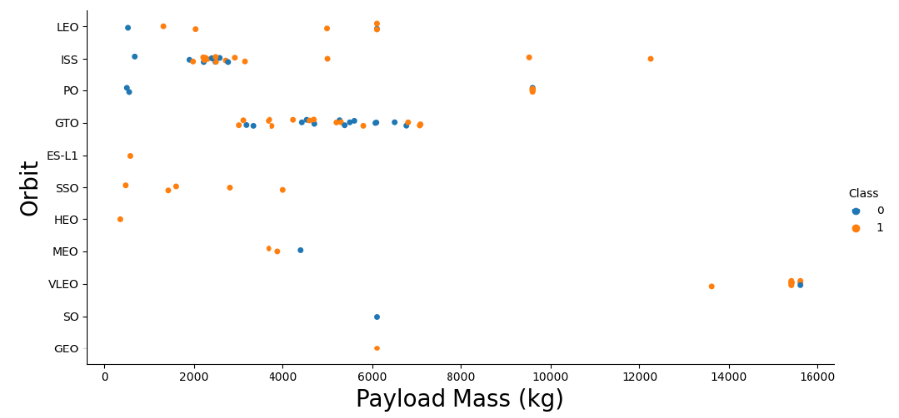
Payload vs. Orbit Type
PO,ISS,LEO showed an increase in success rate as payload increased.
VLEO was generally associated with higher payloads.
There is little to no relationship between payload and success for GTO.

Slide 23
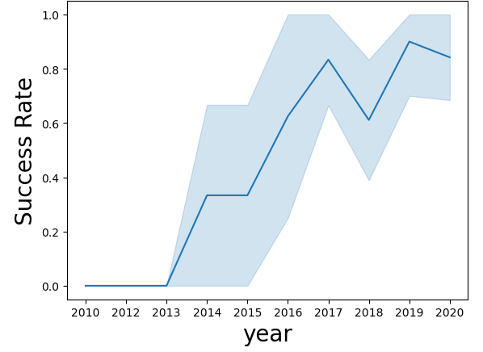
Launch Success Yearly Trend
In 2010 - 2013, there was 0 successful launches.
After 2013, the success rate was generally increasing.
There were small dips in the success rate in 2018 and 2020.
After 2016, the success rate was constantly over 50%.

Slide 24
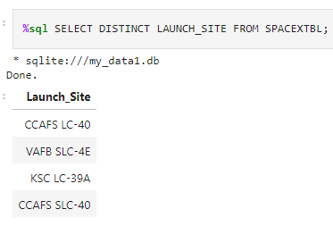
All Launch Site Names
Using the SELECT DISTINCT clause, unique launch site names were found from the launch_site column of the SPACEXTBL table.

Slide 25
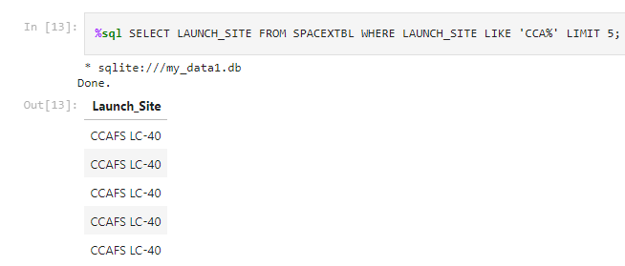
Launch Site Names Begin with 'CCA'
Using the LIMIT 5 clause, we filtered the data to show only 5 results.
Using the LIKE clause and the % placeholder symbol, we were able to find results from the data that began with CCA regardless of the ending characters.

Slide 26
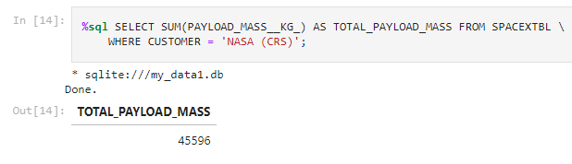
Total Payload Mass
Using the SUM function, we calculated the sum of payload masses and saved it as tital_payload_mass.
Using the WHERE clause, we filtered the data to only be calculated if the customer was NASA (CRS).

Slide 27
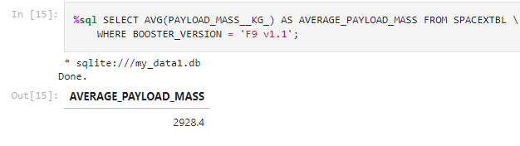
Average Payload Mass by F9 v1.1
Using the AVG function, we calculated the average payload mass and saved it in the column average_payload_mass.
Using the WHERE clause, we filtered the data to only be calculated if the booster version was F9 v1.1.

Slide 28
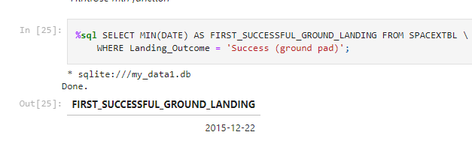
First Successful Ground Landing Date
The MIN function was used to find the first date (minimum date).
The WHERE clause was used to filter the data to only include the landing outcomes Success (ground pad).

Slide 29
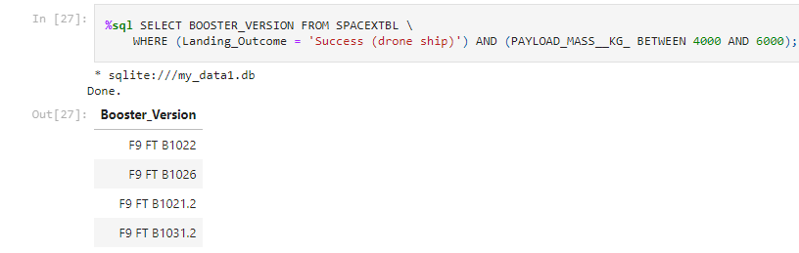
Successful Drone Ship Landing with Payload between 4000 and 6000
The booster versions were selected using the SELECT clause.
the WHERE clause filtered the data to only include results that were success (ground pad) AND had a payload between 4000kg - 6000kg.

Slide 30
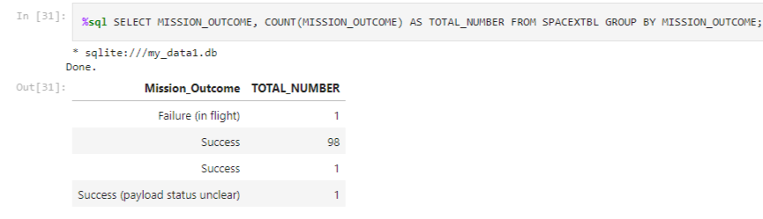
Total Number of Successful and Failure Mission Outcomes
The COUNT function was used to total the number of mission outcomes.
The GROUP BY clause was used to sort the counted data by mission outcomes

Slide 31
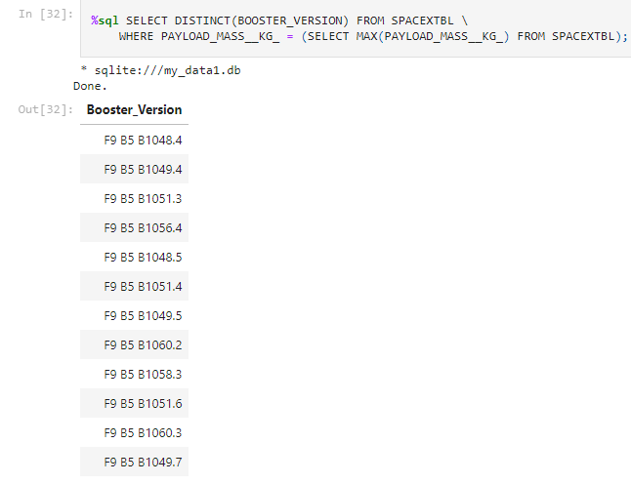
Boosters Carried Maximum Payload
Boosters that carried the max payload:
F9 B5 B1048.4, F9 B5 B1048.5, F9 B5 B1049.4, F9 B5 B1049.5, F9 B5 B1049.7, F9 B5 B1051.3, F9 B5 B1051.4, F9 B5 B1051.6, F9 B5 B1056.4, F9 B5 B1058.3, F9 B5 B1060.2, F9, B5 B1060.3.

Slide 32
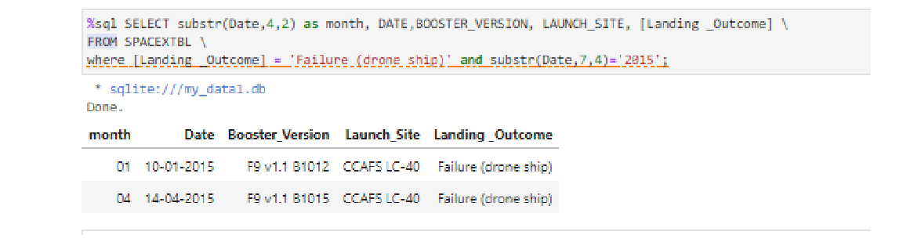
2015 Launch Records
List the failed landing_outcomes in drone ship, their booster versions, and launch site names for in year 2015

Slide 33
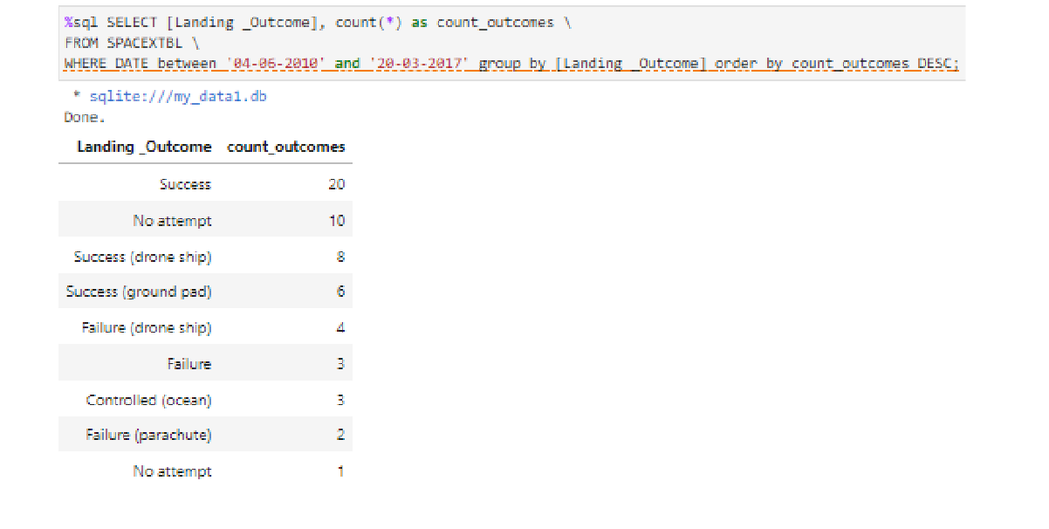
Rank Landing Outcomes Between 2010-06-04 and 2017-03-20
Rank the count of landing outcomes (such as Failure (drone ship) or Success (ground pad)) between the date 2010-06-04 and 2017-03-20, in descending order

Slide 34

Section 3

Slide 35
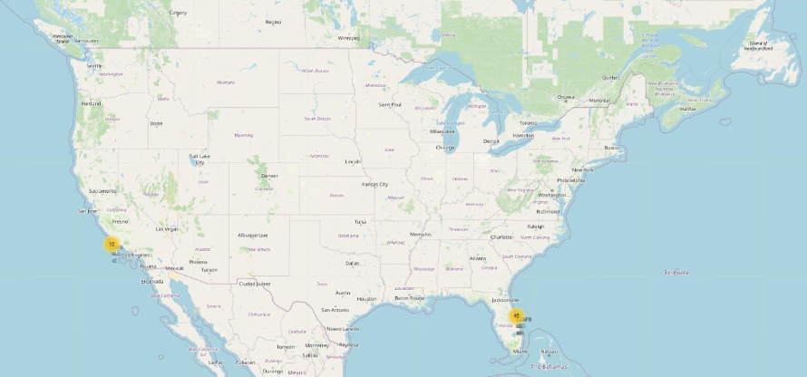
All Launch Sites on a Map
All launch sites are located on the coast of the U.S. specifically around Florida and California.

Slide 36
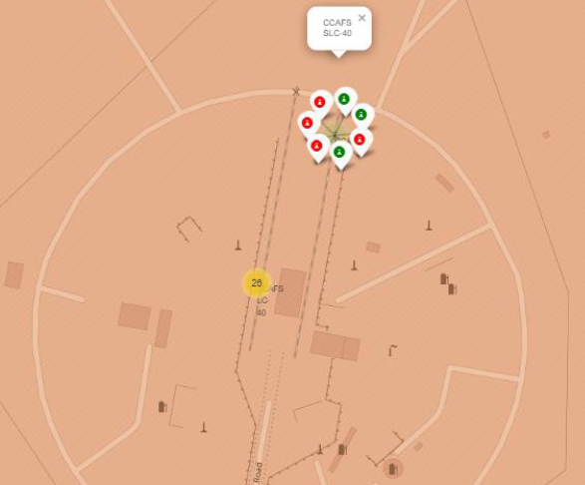
Failed and Successful launches at each site
Launches were grouped into clusters at each sight and colored red for failed launches and green for successful launches accordingly.

Slide 37
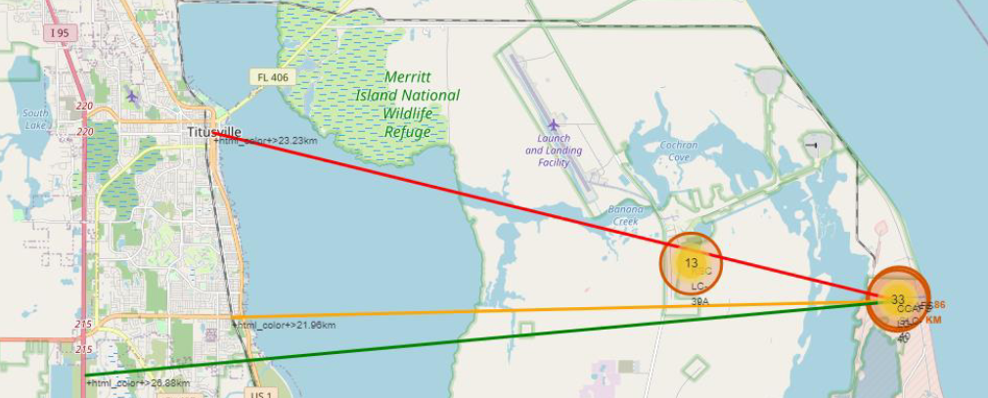
Launch Site Proximity to Other Interest Points
CCAFS SLC-40 launch site:
Coastline is 0.87kn due east
highway is 0.59km away
railway is 1.29km away
nearest city is 51.74km away.

Slide 38

Section 4

Slide 39
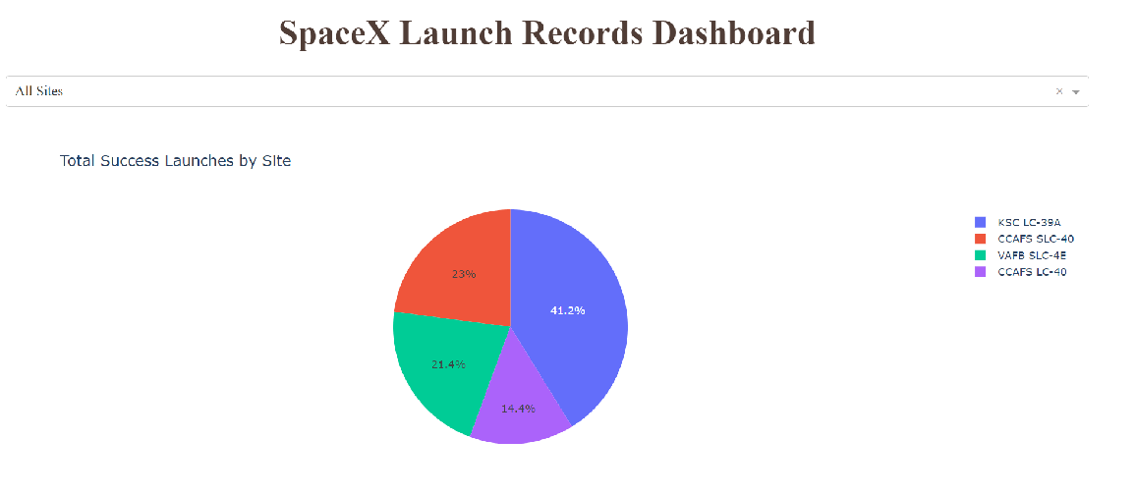
Launch Success Rate for Each Site
KSC LC-39A has the highest success rate with 41.7% of all successful launches.

Slide 40
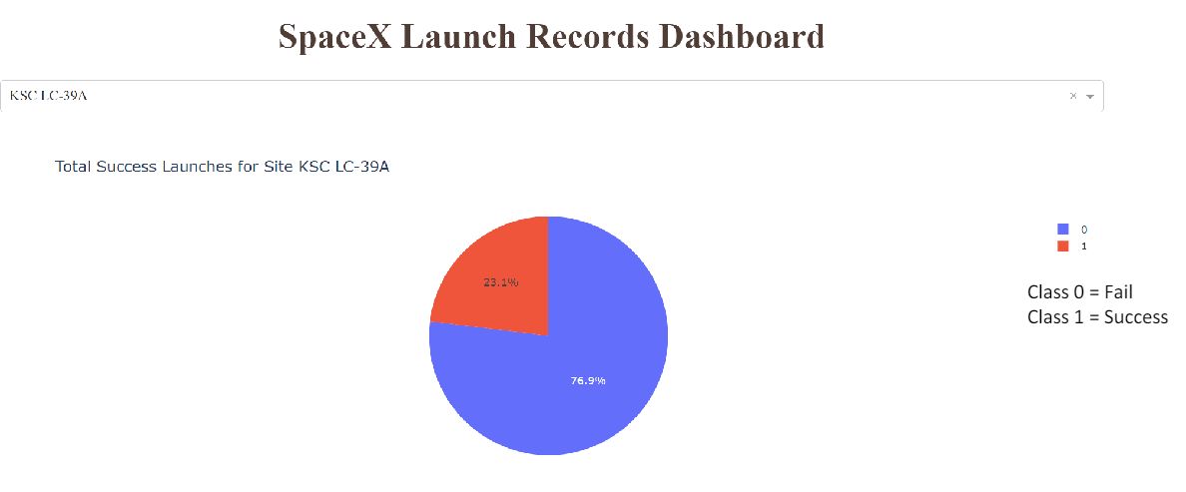
Breakdown of Launches at KSC LC-39A
76.9% of launches at KSC LC-39A were successful whereas 23.1% failed giving KSC LC-39A the highest success rate.

Slide 41
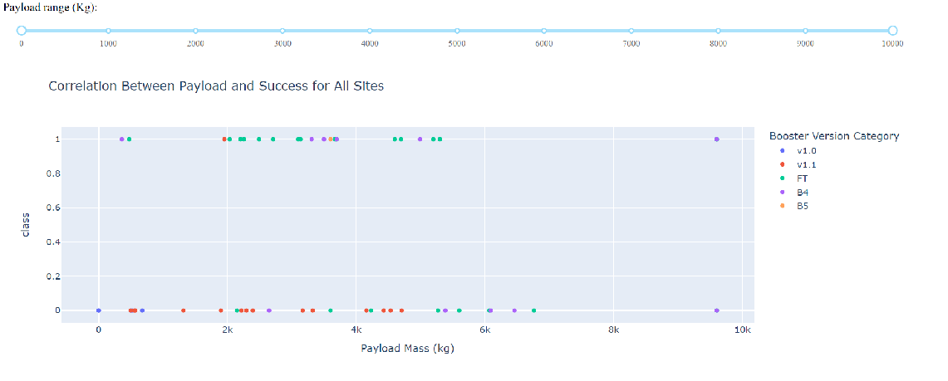
Launch Outcome and Payload for All Sites
Lower payloads had greater success than heavier payloads.
Some boosters were not launches with heavier payloads.

Slide 42

Section 5

Slide 43
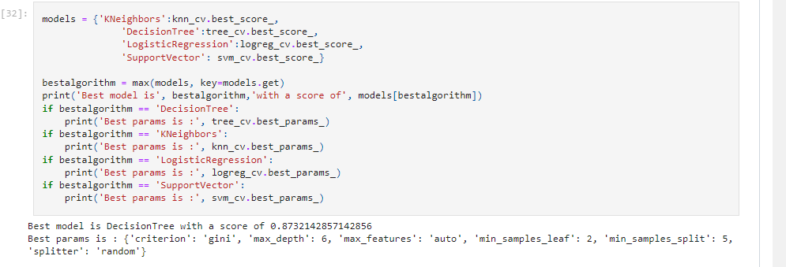
Classification Accuracy
The decision tree method was the best classification model with an 87.32% accuracy score.

Slide 44
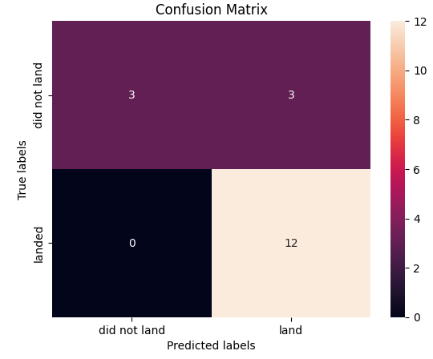
Confusion Matrix
The confusion matrix shows 15 correctly identified outcomes and 3 incorrectly identified outcome resulting in a 83.33% accuracy.

Slide 45
Conclusions
As the number of flights increase, the success rates increased.
2010 - 2013: 0% success rate, after 2013: generally increasing success rate, after 2016: over 50% success rate.
Orbit types ES-L1, GEO, HEO, SSO had the highest success rate. SSO had the most successful launches.
Orbit types PO, ISS, LEO, VLEO had the most successful launches with heavy payloads.
KSC LC-39A was the most successful launch site.
Lower payloads had a higher success rate than heavy payloads, but also had more launches than higher payloads.

Slide 46
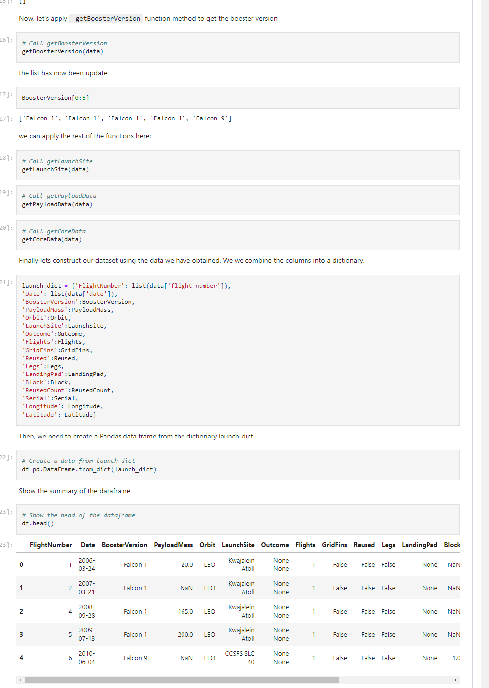
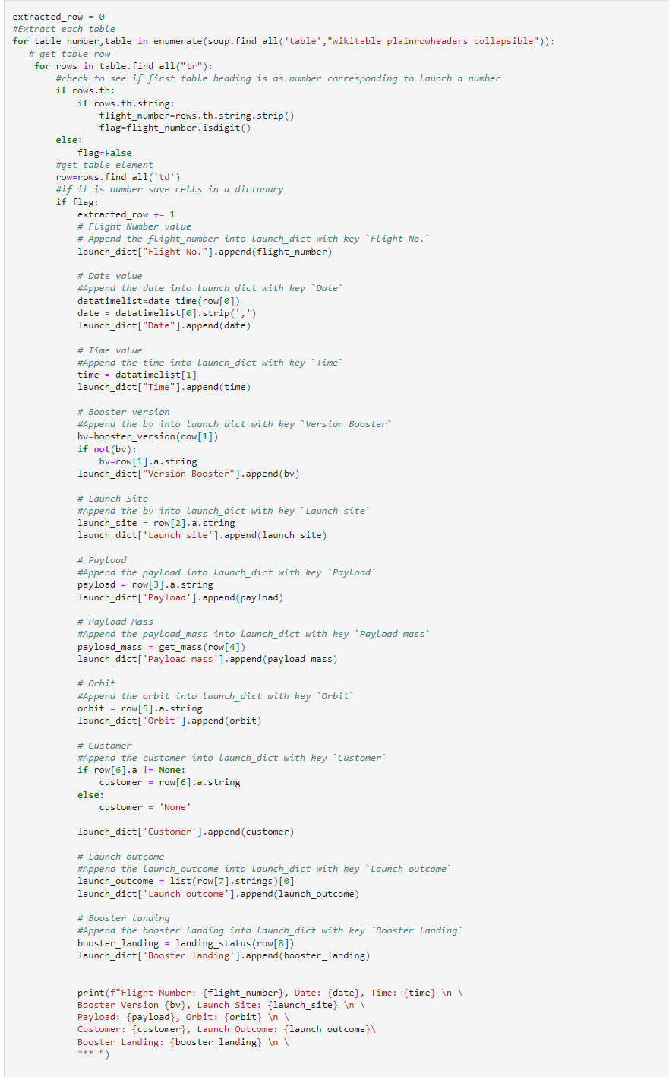
Appendix- Space X REST API & Web Scraping
REST API Web Scraping

Slide 47


